Slide 1
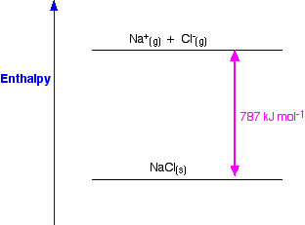
Lattice enthalpy is simply the change in Enthalpy associated with the formation of one mole of an ionic compound from its gaseous ions under standard conditions.

Slide 2
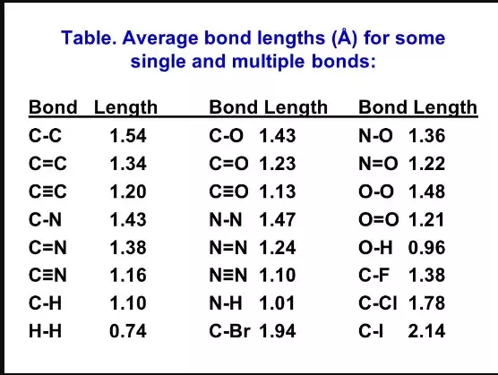
Bond length or bond distance is defined as the average distance between nuclei of two bonded atoms in a molecule. It is a transferable property of a bond between atoms of fixed types, relatively independent of the rest of the molecule.

Slide 3
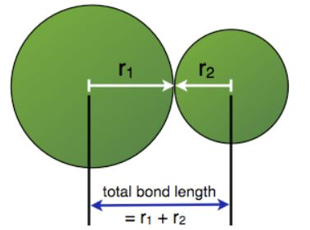

Slide 4
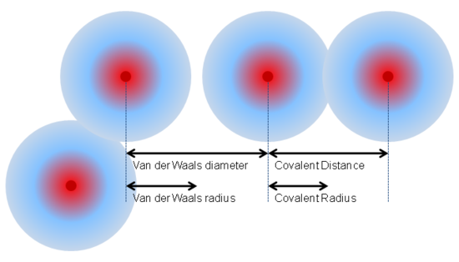

Slide 5
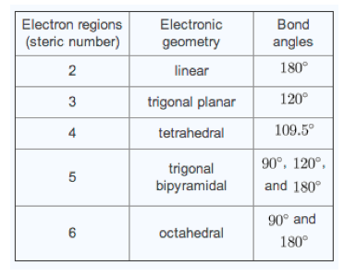
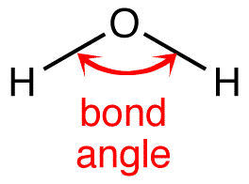
A bond angle is the angle between two bonds originating from the same atom in a covalent species

Slide 6
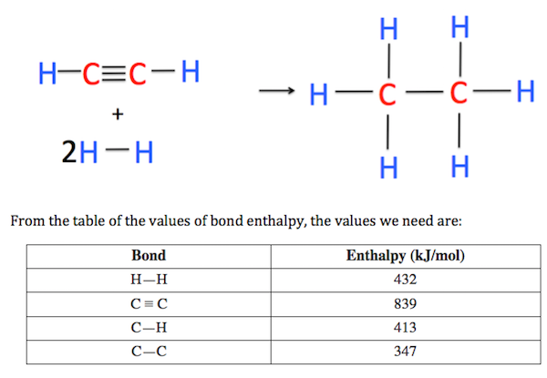
Bond enthalpy (also known as bond energy) is defined as the amount of energy required to break one mole of the stated bond. For example, the bond energy of a O-H single bond is 463 kJ/mol.

Slide 8
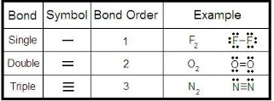
Bond order is a measurement of the number of electrons involved in bonds between two atoms in a molecule. It is used as an indicator of the stability of a chemical bond. Most of the time, bond order is equal to the number of bonds between two atoms.

Slide 9
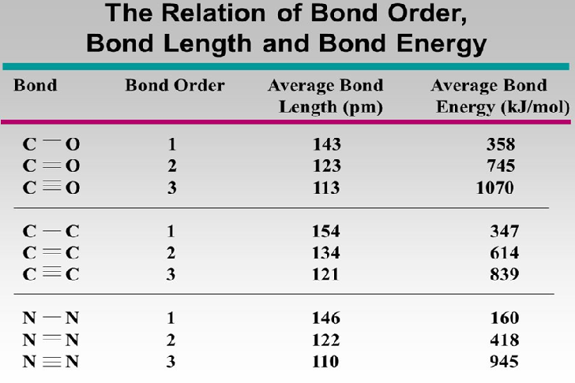

Slide 10
RESONANCE STRUCTURE
In chemistry, resonance is a way of describing bonding in certain molecules or ions by the combination of several contributing structures known as resonance structures or canonical structures into a resonance hybrid

Slide 11
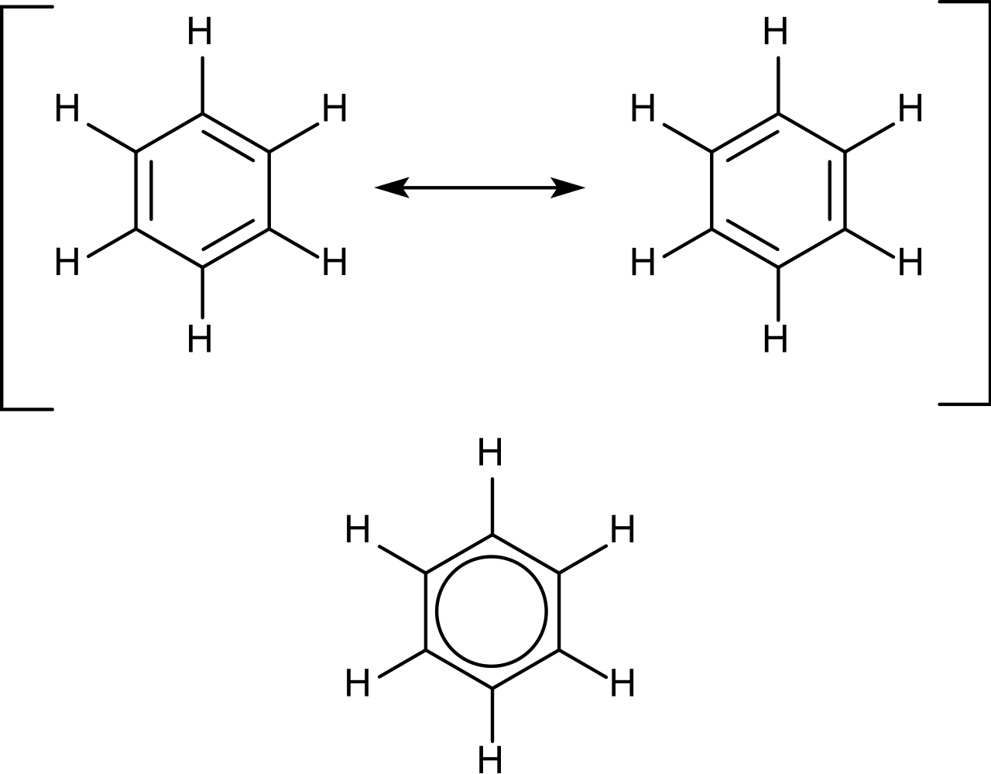
RESONANCE STRUTURE OF BENZENE

